Slide 1


Slide 2


Emotion detection app
User Manual
Author: Yashjit Das

Slide 3
Table of Contents
1. Acknowledgements
page
2. Abouts page
3. About app

Slide 4
Acknowledgements
I’d like to thank:
Clevered
Avishek Sir
Clevered Team

Slide 5

About Me…
About my journey…
My journey’s been great so far. I like how the teachers teach me, and clear my doubts.
I am thankful to Clevered and the Team.
I am Yashjit Das, age 12. I am currently in 7th grade and have completed my basic journey with Python.

Slide 6
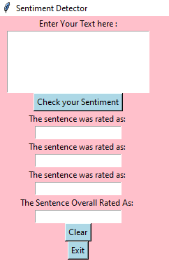
About App…
This app allows the user to check his/her emotion by writing in the space provided.

Slide 7
How do I use the App?
When we write in the space provided, and click on the button ‘Check your
Sentiment’, the app calculates the percentage of emotions, and rates off your overall sentiment.

Slide 8



After typing the text, click on this button to calculate your emotion.
Please do NOT press this button again and again, your calculated mood will be typed repeatedly.
After getting to know your sentiment, please erase your overall percentage and other criteria with this button.
To close the pop-up, click on this button.

Slide 9
Terms and conditions
This app has been worked on diligently over the
past few months to ensure that you, the users, can have the best experience possible. Some aspects might need some polishing. If you have any suggestions, please email me at ‘yashjitdas@yahoo.com’ .

Slide 10
Thank you!

